Slide 1
SELinux
Evan Reichard

Slide 2
WTF is SELinux?
setenforce 0
The End
Notes:
SELinux stands for “Security Enhanced Linux”
Most OS’s use Discretionary Access Control (DAC) whereas SELinux introduces Mandatory Access Control (MAC)
DAC on *NIX systems define read, write, execute on an individual, group and everyone else. They are user defined.
MAC / SELinux is context based. Each process and file has a security context that contains relevant security information. The system uses policies to enforce these interactions and is an administratively defined permission model.

Slide 3


Slide 4
lol jk
Notes:
SELinux stands for “Security Enhanced Linux”
Most OS’s use Discretionary Access Control (DAC) whereas SELinux introduces Mandatory Access Control (MAC)
DAC on *NIX systems define read, write, execute on an individual, group and everyone else. They are user defined.
MAC / SELinux is context based. Each process and file has a security context that contains relevant security information. The system uses policies to enforce these interactions and is an administratively defined permission model.

Slide 5
WTF is SELinux?
setenforce 0
ಠ_ಠ
At least try! (I’ll show you how)
Discretionary Access Control (DAC) vs. Mandatory Access Control (MAC)
DAC: -rwxrwxrwx (user, group, everyone else)
User defined
User: “lol idk wat im doing, chmod -R 777 /var/www/html/”
MAC / SELinux: system_u:object_r:admin_home_t:s0 (user, role, type, level)
Type Enforcement (TE), Multi-Category Security (MCS), Multi-Level Security (MLS)
Administratively defined
Notes:
SELinux stands for “Security Enhanced Linux”
Most OS’s use Discretionary Access Control (DAC) whereas SELinux introduces Mandatory Access Control (MAC)
DAC on *NIX systems define read, write, execute on an individual, group and everyone else. They are user defined.
MAC / SELinux is context based. Each process and file has a security context that contains relevant security information. The system uses policies to enforce these interactions and is an administratively defined permission model.

Slide 6
continued...
Role-Based Access Control (RBAC)
Users are authorized for roles, roles are authorized for domains. [1]
system_u -> object_r -> admin_home_t
Roles ultimately control what object types can be accessed; They are the intermediary between users and type.
Notes:
[1] https://access.redhat.com/documentation/en-US/Red_Hat_Enterprise_Linux/7/pdf/SELinux_Users_and_Administrators_Guide/Red_Hat_Enterprise_Linux-7-SELinux_Users_and_Administrators_Guide-en-US.pdf (Page 12)

Slide 7
The Basics
Subjects & Objects
Subjects: person, process, or device. [1]
Object: files, sockets, pipes or network interfaces that are accessed via processes. [2]
SELinux policy is consulted only if DAC permits. [3]
I.e. If httpd is trying to access file fav_tswift_songs.csv (size: 20MB) owned by user tfo with permissions 600 (-rw-------), it will flat out deny access regardless of subject and object SE contexts. (DAC has no read access for httpd so SELinux policy isn’t consulted)
Confined vs. Unconfined domains
A confined domain is a domain where a policy exists already (E.g. httpd)
An unconfined domain resulted in the realization that we can’t create a policy for literally every situation. The unconfined domain basically gets complete access to the system governed by DAC. [4]
Notes:
[1] http://selinuxproject.org/page/NB_Subjects
[2] http://selinuxproject.org/page/NB_Objects
[3] https://access.redhat.com/documentation/en-US/Red_Hat_Enterprise_Linux/7/pdf/SELinux_Users_and_Administrators_Guide/Red_Hat_Enterprise_Linux-7-SELinux_Users_and_Administrators_Guide-en-US.pdf (Page 6)
[4] http://danwalsh.livejournal.com/9031.html

Slide 8
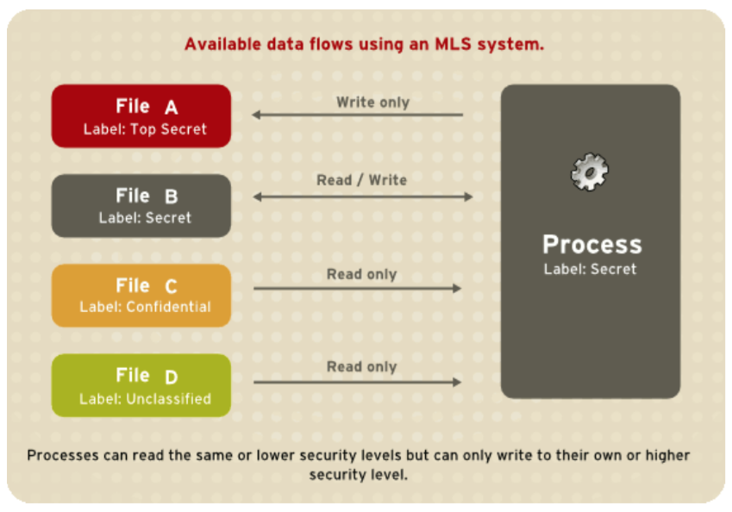
SELinux Modes / Types
Targeted (Default)
Subjects confined or unconfined*
DAC -> TE - > MCS
Single level
Strict (Older)
Same as targeted, but confined
Minimum (Newer)
Unconfined by default
Apply policies manually
MLS
DAC - > MLS
Multi-Level Security that conforms to the Bell-La Padula Access Model.
Source: RHEL 7 SELinux Users & Administration Guide, MLS Data Flow (Page 56)
Notes:
Targeted policy used to only allow unconfined users. Strict was later merged into the targeted policy.

Slide 9
Type / Domain Access
Objects and subjects contain a type, indicated by an appended “_t”
Object & subject scope type access can vary based on policy.
A subject in the unconfined_t domain has access to whatever DAC allows it.
Domain transition rules dictate what transitions can happen
(E.g. An unconfined_t user executes /bin/passwd, transitioning to passwd_exec_t, which is allowed to transition to shadow_t in order to read /etc/shadow)
Additional constraints can be added by a policy builder to different types in order to allow or constrain transitions to different domains.

Slide 10
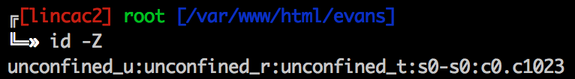
MLS / MCS
s0-s0:c0.c1023 is the level in this example:
The level is made up of the sensitivity and category values (s & c, respectively)
MCS has one sensitivity, s0 (as indicated by s0-s0). MLS can have many.
Categories are optional
How is access determined? Dominance rules ;)
No, really.
Jared dominates Bryan: If the sensitivity of Jared is equal to or higher than the sensitivity of Bryan and the categories of Jared are the same or a superset of the categories of Bryan. [1]
Since MCS only has one sensitivity level, dominance is only determined based on category.
Notes:
There are only 1024 categories (0 - 1023)
Traditionally, maximum sensitivity is s15 (compile time option)
These dominance rules work in collaboration with the Bell-La Padula Access Model diagram in the previous slide.
[1] http://selinuxproject.org/page/NB_MLS

Slide 11
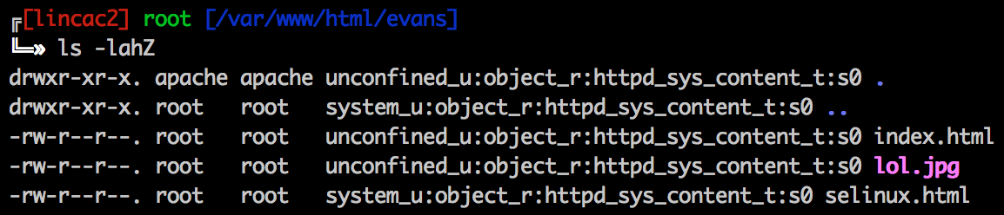
Reading Contexts (-Z)
ps aux -Z
ls -lahZ
id -Z
Notes:
You can see that my user is running as unconfined (id -Z). This is using the default RHEL 7 targeted SELinux policy. Any processes spawned by my user will be run as unconfined as well.

Slide 12
Tools
Install shit u need first tho
yum install setroubleshoot setools-console policycoreutils-devel -y
chcon (Changes context)
chcon --reference=/var/www ~/public_html/
chcon <context> /path/to/a/newfile
sealert (Searches for any SELinux alerts within audit.log)
sealert -a /var/log/audit/audit.log
restorecon (Restores the context of a file to the defaults)
restorecon -v /path/to/a/file
Restores to context defined within: /etc/selinux/targeted/contexts/files/file_contexts

Slide 13
Policy Generation Tools
audit2allow (Generates SELinux policies based off of audit.log errors)
audit2allow -a -M <module_t.te>
audit2why (Why was access denied?)
audit2why -a
checkmodule (Module compiler)
checkmodule -M -m -o <module_t.mod> <module_t.te>
semodule_package (Create an SELinux module package)
semodule_package -o <module_t.pp> -m <module_t.mod>
semodule (Installs the created module)
semodule -i <module_t.pp>

Slide 14
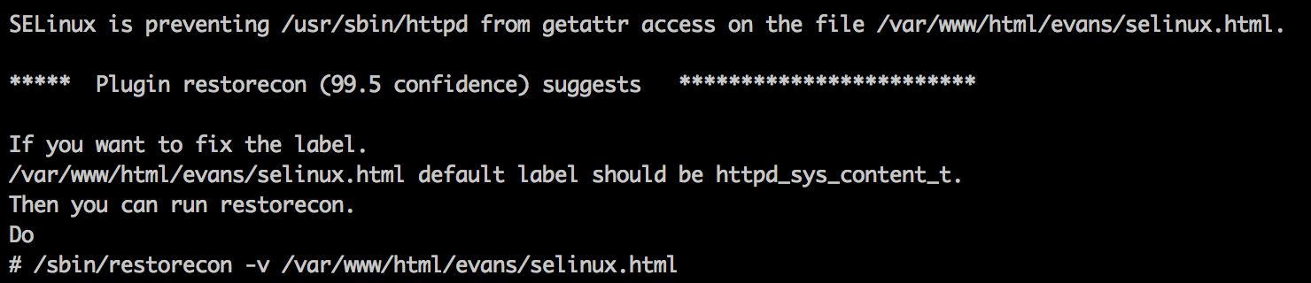
Troubleshooting SELinux
sealert -a /var/log/audit/audit.log
This will usually tell you what’s wrong!
You mean all I have to do is run: restorecon -v /var/www/html/evans/selinux.html !?!?

Slide 15
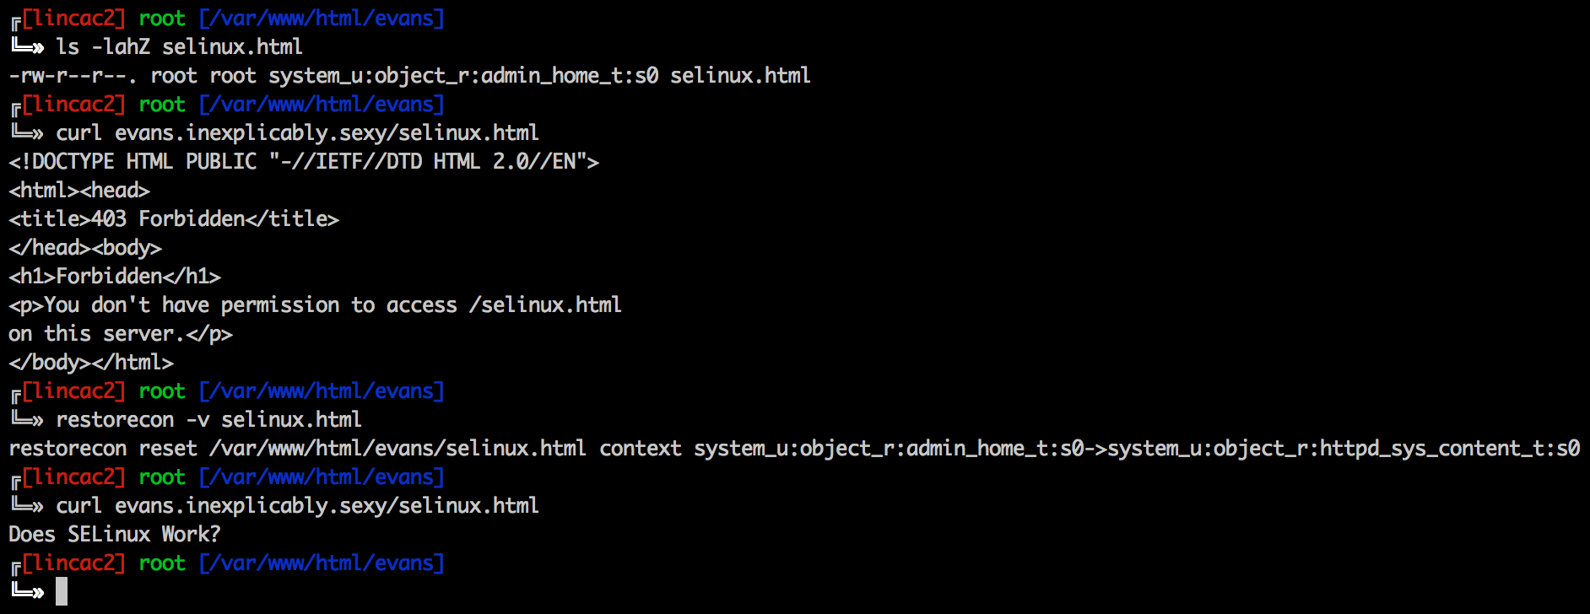
(Yes that’s a real website…)

